Slide 1
Theory of Automata and Formal Language Lecture-40 Dharmendra Kumar (Associate Professor) Department of Computer Science and Engineering United College of Engineering and Research, Prayagraj March 30, 2021

Slide 2
Post Correspondence Problem(PCP)
The PCP problem over an alphabet ∑ is stated as follows:−
Given the following two lists, X and Y of non-empty strings over ∑,
X = (x₁, x₂, x₃,………, x_{n})
Y = (y₁, y₂, y₃,………, y_{n})
We can say that there is a Post Correspondence Solution, if for some (i₁,i₂,………… i_{k}), where 1 ≤ i_{j} ≤ n, the condition x_{i1} x_{i2} …….x_{ik} = y_{i1} y_{i2} …….y_{ik} satisfies.

Slide 3
Ex. Find whether the lists X = (abb, aa, aaa) and
Y = (bba, aaa, aa) have a Post Correspondence Solution?
Solution:
Here,
x₂x₁x₃ = ‘aaabbaaa’
and y₂y₁y₃ = ‘aaabbaaa’
We can see that
x₂x₁x₃ = y₂y₁y₃
Hence, the solution is (2, 1,3). Another solution may be also (2, 3), (3, 2).

Slide 4
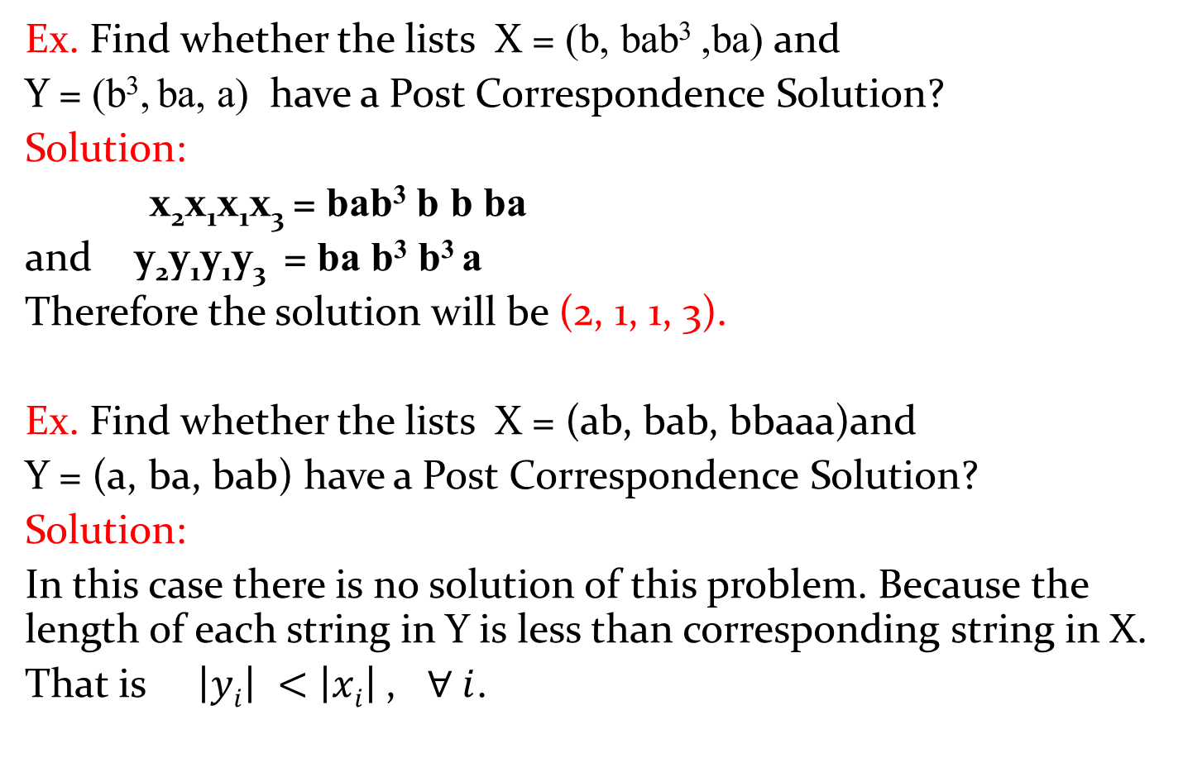
Ex. Find whether the lists X = (b, bab³ ,ba) and
Y = (b³,ba, a) have a Post Correspondence Solution?
Solution:
x₂x₁x₁x₃= bab³ b bba
and y₂y₁y₁y₃ = ba b³b³a
Therefore the solution will be (2, 1, 1, 3).
Ex. Find whether the lists X = (ab, bab, bbaaa)and
Y = (a, ba, bab) have a Post Correspondence Solution?
Solution:
In this case there is no solution of this problem. Because the length of each string in Y is less than corresponding string in X.
That is $\left|yi\right| <$$\left|xi\right|$, $∀ i$.

Slide 5
Modified Post correspondence problem (MPCP)
The modified PCP problem over an alphabet ∑ is stated as follows:−
Given the following two lists, X and Y of non-empty strings over ∑,
X = (x₁, x₂, x₃,………, x_{n})
Y = (y₁, y₂, y₃,………, y_{n})
We can say that there is a Modified Post Correspondence Solution, if for some (i₁,i₂,………… i_{k}), where 1 ≤ i_{j} ≤ n, the condition x₁ x_{i1} x_{i2} …….x_{ik} = y₁ y_{i1} y_{i2} …….y_{ik} satisfies.

Slide 6
Universal Turing machine(UTM)
A universal Turing machine (UTM) behaves like a general purpose computer. Instead of finite size memory in computer, UTM uses infinite tape.
UTM is a specified TM that can simulate the behavior any TM.
UTM is a Turing machine that accepts universal language.
Universal language is defined as:-
UL= { <M,w> ! M is a Turing machine that accepts input string w.}
Desciption of TM
UTM
Accept,
Reject,
Goes into infinite loop
w

Slide 7
Universal Turing machine(UTM)
Input to UTM:
Description of TM
Input string
Action of UTM:
Simulate TM
Behave like TM
UTM as Computer
TM as Program
UTM is a recognizer but not a decider.
UTM takes an encoding of a TM and the input data as its input in its tape and behaves as that TM on the input data.

Slide 8
Church-Turing Thesis
It states that if there exists an algorithm to solve a problem then there exists a Turing machine to solve that problem and vice-versa.
It states that a function on the natural numbers can be computed by an algorithm if and only if it is computable by a Turing machine.
A problem can be solved by an algorithm iff it can be solved by a Turing Machine.
Algorithm Turing machine

Slide 9
Halting Problem
Statement: Given Turing machine M and input string w, is it possible to determine whether the machine will ever halt on given input string?
In another words, the halting problem is the problem of determining, from a description of an arbitrary computer program and an input, whether the program will finish running, or continue to run forever.
Halt: the machine will stop or halt at final or non-final state after finite number steps.
No halt: Machine will never stop or halt.

Slide 10
Decidable or Undecidable Problem
A problem is said to be decidable if there exists an algorithm which can decide the problem in finite amount of time.
In this type of problems, the output of the algorithm will be yes/no i.e. the answer of decidable problems is yes or no.
A problem is said to be undecidable if there does not exist an algorithm which can decide the problem in finite amount of time.

Slide 11
Turing decidable and Turing acceptable language
A language L is said to be Turing decidable if there exists a Turing machine which can accepts all strings belong in to L and rejects all strings which do not belong into L.
A language L is said to be Turing acceptable if there exists a Turing machine which can accepts all strings belong in to L.

Slide 12
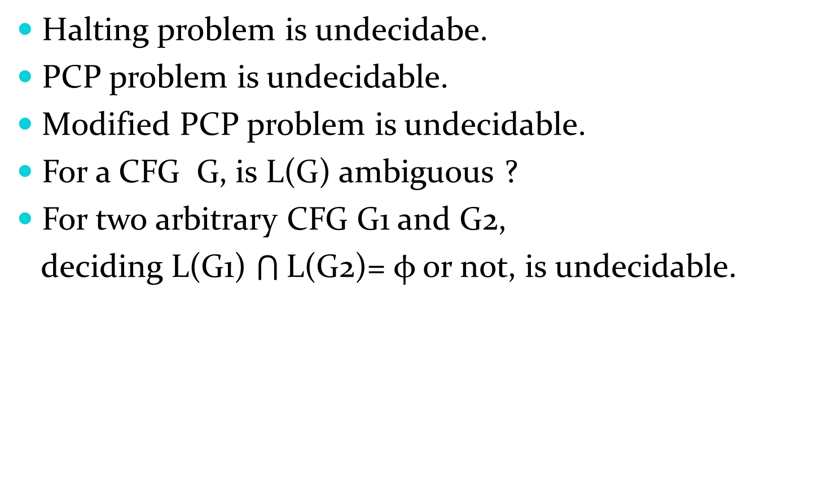
Some undecidable problems
Halting problem is undecidabe.
PCP problem is undecidable.
Modified PCP problem is undecidable.
For a CFG G, is L(G) ambiguous ?
For two arbitrary CFG G1 and G2,
deciding L(G1)$\bigcap{\text{L}\text{(}\text{G}\text{2)}}$= φ or not, is undecidable.

Slide 13
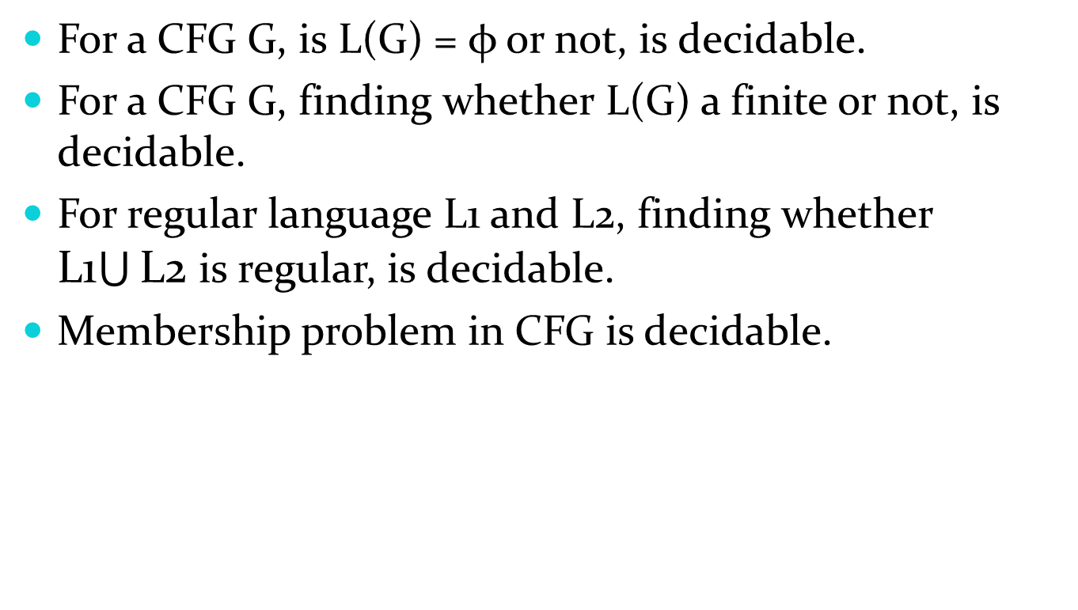
Some decidable problems
For a CFG G, is L(G) = φor not, is decidable.
For a CFG G, finding whether L(G) a finite or not, is decidable.
For regular language L1 and L2, finding whether L1$\bigcup{\text{L}\text{2}}$ is regular, is decidable.
Membership problem in CFG is decidable.

